Slide 1
Deep learning with PyTorch
Francesca Manni

Slide 2
Agenda
Deep learning
PyTorch
Beyond conventional learning
Time for hands-on session

Slide 3


Introduction
Goals of today:
Starting from basic
Understand complexity
Sharing knowledge
Learning by doing

Slide 4

About me
Francesca AI Scientist
Data & AI Scientist at Philips Research
PhD in AI for medical imaging
MSc in Biomedical Engineering
Passion for healthcare
A lot of curiosity ☺
…and I am Italian!

Slide 5
Deep Learning
What is PyTorch?

Slide 6
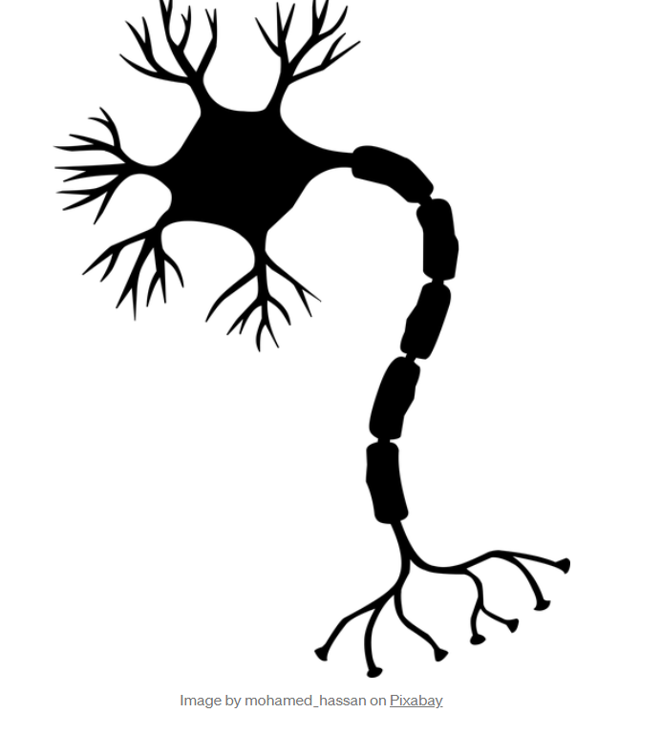
DL basis
DL is a machine learning technique
It injects inputs through layers to learn a prediction
Inputs can be images, text, signals, etc.
Inspired by how human brain filters and process information.

Slide 7
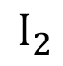
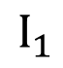
DL basis
Input layer
hidden layer
output layer
In DL models we have connected layers.
1- The first layer is called the Input Layer
2- The last layer is called the Output Layer
3 - All layers in between are called Hidden Layers.
NB: When a network is deep neural network it means that we might have more than two layers!
$$I_{1}$$
$$I_{2}$$
Output data
Input data

Slide 8
DL basis
How does it learn? The neural net applies a non-linear transformation to the input and create an output (model). Afterwards, this model is improved by back-prop (derivatives). This is repeated many many times until a good level of accuracy is reached.
The simplest network is the feed-forward neural networks. The information’s flows starts at the input layer, goes to the “hidden” layers, and end at the output layer. The network
More complex networks are e.g. convolutional neural network: typical for unstructured data (like images), it uses a layer that performs a dot product of the convolution kernel.

Slide 9
It’s not all about coding!
Understand the problem
Identify your data
Select the DL algo
Train and Test your model

Slide 10
PyTorch
What is PyTorch?
PyTorch documentation — PyTorch 1.13 documentation

Slide 11

PyTorch basics
Deep learning framework
It’s Python-based
GPU accelerated (fast and flexible)
Tensors are the PyTorch hearth
Beneficial as machine learning solutions
Data scientists
Researchers
Software engineers
Software developers

Slide 12
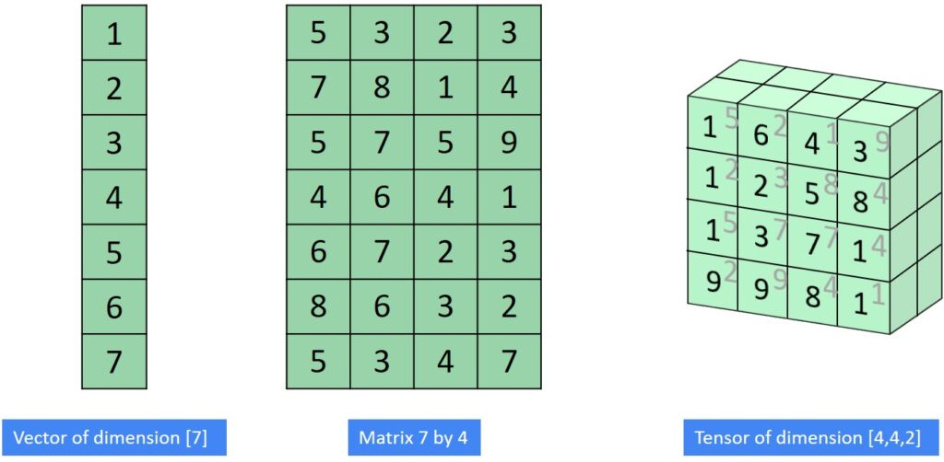
Tensors
Tensors are data structure (similar to arrays and matrices, e.g. NumPy arrays).
PyTorch uses tensors to encode the inputs and outputs of a model, as well as the model’s parameters.
Tensors can run on GPUs and are also optimized for automatic differentiation (torch.autograd)!
Vector dim = 7
Matrix dim = 7 x 4
Tensor dim = [4,4,2]

Slide 13
Datasets and DataLoaders
PyTorch provides two data loaders:
torch.utils.data.DataLoader and torch.utils.data.Dataset that allow you to use pre-loaded datasets as well as your own data. Dataset stores the samples and their corresponding labels
DataLoader wraps an iterable around the Dataset to enable easy access to the samples. Main features of DataLoader are:
The __init__ function is run once when instantiating the Dataset object.
The __len__ function returns the number of samples in our dataset.
The __getitem__ function loads and returns a sample from the dataset at the given index idx.

Slide 14
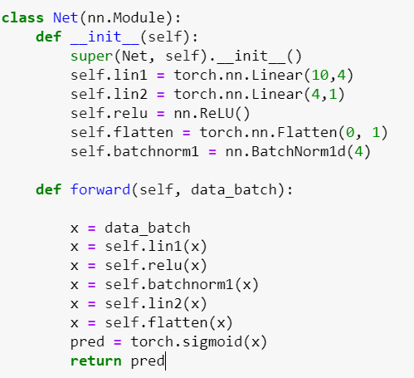
Build a model
We define our neural network class with nn.Module, and initialize the neural network layers in __init__.
Every nn.Module subclass implements the operations on input data in the forward method.

Slide 15
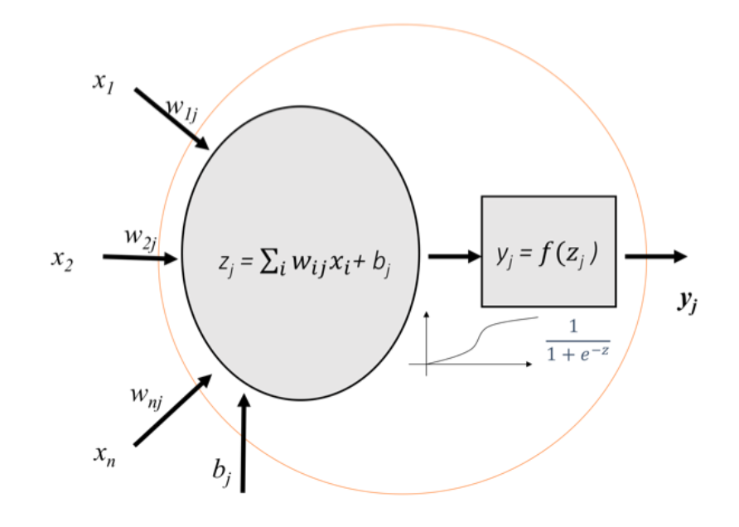
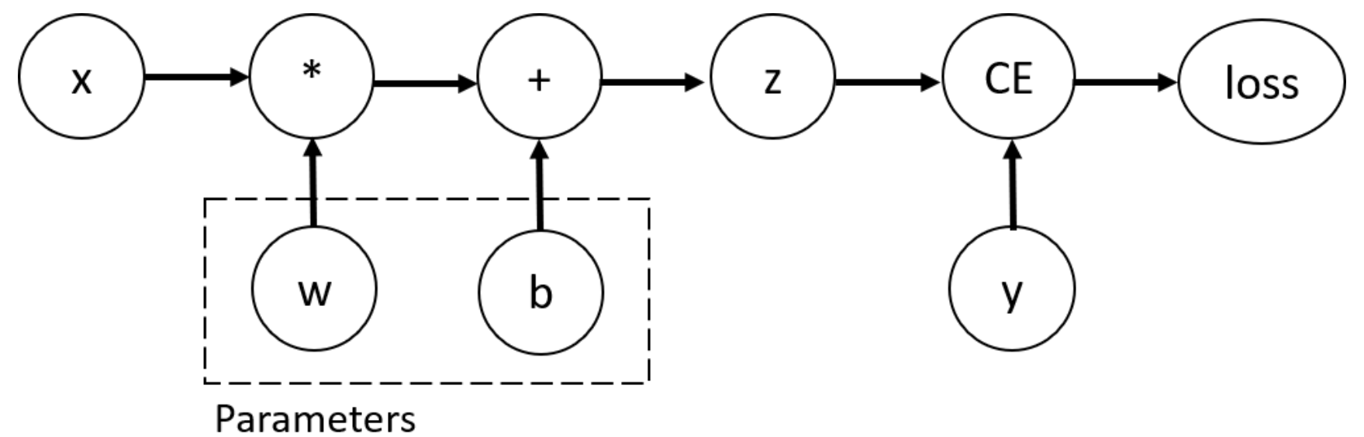
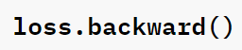
Training
w and b are parameters, which we need to optimize and to do so we need to compute the derivatives of our loss function with respect to parameters. We stop tracking the computation activate with required_grad=True with torch.no_grad()

Slide 16
Hyperparameters
Epochs - the number times to iterate over the dataset
Batch Size - data samples propagated through the network before the parameters are updated
Learning Rate - how much to update model parameters at each batch/epoch.

Slide 17
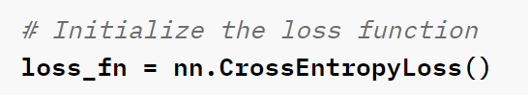
Loss function and optimizer
Loss function measures the error made by the predicted output and the target value, and it is the loss function that we want to minimize during training.
We adjust the model parameters by implementing optimization algorithms at each training round.

Slide 18
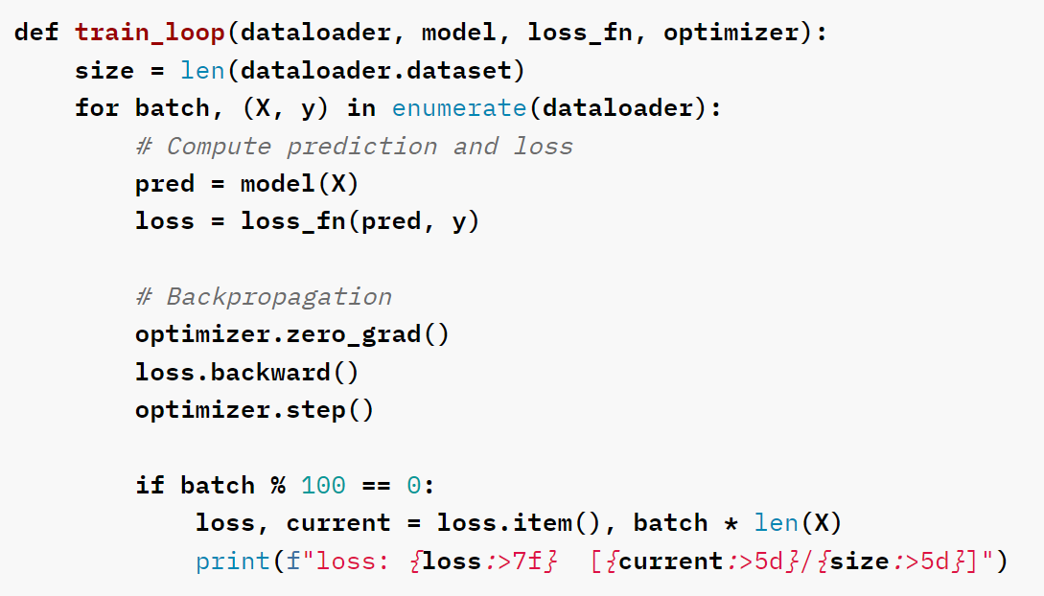
The full training with PyTorch

Slide 19
Familiarize with PyTorch
Basic steps to start learning
Learn how to load data
Build a deep neural network
Train and test your model

Slide 20

The way to get started is to quit talking and begin doing.
Walt Disney

Slide 21
Timeline
Start with downloading the data and get familiarity
1
Set up the proper preprocessing if needed
2
Designing your neural net
3
Training and testing
4
Federated learning: explaining a simple notebook to get an idea
5

Slide 22


Slide 23
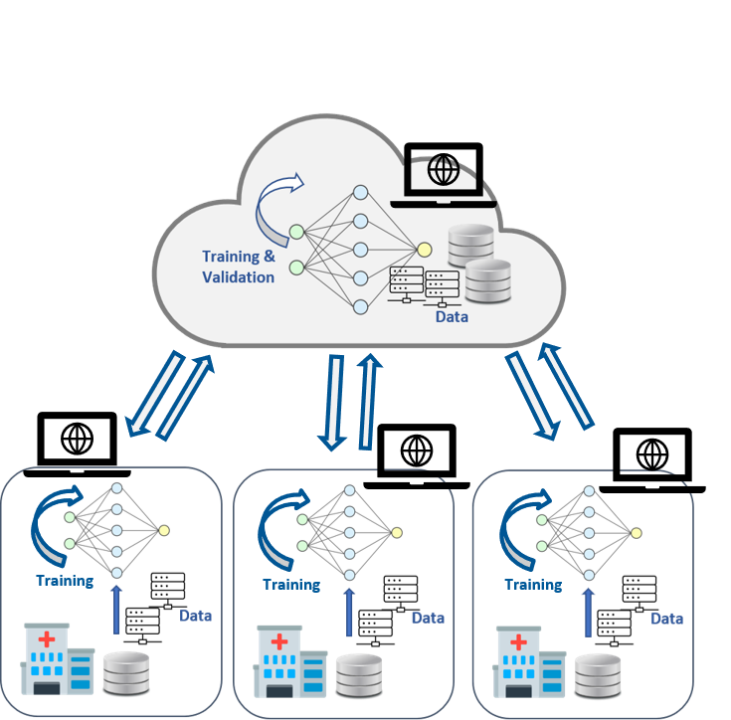
An extended concept: Federated Learning
How to train your model by with other silos without sharing the data?
We can do it with PyTorch!

Slide 24
Thank you!
Francesca Manni
Francescang.manni@gmail.com

